Slide 1
College of Emerging Technology
Graph Algorithms
Notes:
Welcome to this Optum Tech University course on Emerging Technologies

Slide 2
Learning Objectives
After taking this course students will be able to
Have a high-level background of Graph Theory and Terminology
Understand how different graph databases support different Algorithms
Describe various graph algorithms and sample applications
Pathfinding, clustering, centrality detection, similarity
Be able to execute sample queries on synthetic clinical data

Slide 3
Graph Algorithms
One of the advantages of graph databases is the focus that they place on relationships
They are as important, if not more important, than data elements
Graph algorithms are numerous and just like other algorithms, serve very specific purposes for providing statistical data and predictive analyses
This course will provide background and implementations for many exploratory and predictive algorithms

Slide 4
Graph Theory and Terminology
Notes:
Welcome to this Optum Tech University course on Emerging Technologies

Slide 5
Graph Theory and Terminology
Mathematical Graph Theory History
Algorithm Terminology
Algorithm Analysis Terminology
Graph Terminology
Undirected vs. Directed
Connected vs. Disconnected
Sparse vs. Dense
Weighted vs. Unweighted
Traversing Graphs
Local vs Distributed

Slide 6

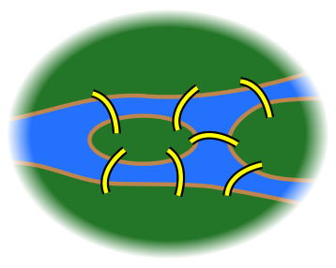
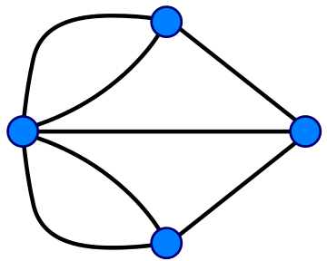
Mathematical Graph Theory History
Seven Bridges of Königsberg
Devise a walk through the city that would cross each of those bridges once and once only
Problem proved to have no solution by Leonhard Euler in 1736
Laid foundation for graph theory

Slide 7
Algorithm Terminology
Set - A collection of objects, such that every object is unique
List - An ordered collection of objects
Duplication is allowed as opposed to a set
Heuristic - Technique designed to solve a problem more quickly and efficiently by sacrificing optimality, completeness, accuracy or precision
Greedy algorithms for example employ the heuristic of making the locally optimal choice at each stage presuming it will lead to the global optimum

Slide 8
Algorithm Analysis Terminology
Big O Notation - Used to formally classify algorithms according to their run time or space requirements as the size of the input grows
The “O” is used as way to communicate the order of the function and place an upper bound on the growth rate of a function as related to input growth
Cost / Run Time - Informally used to describe how computationally expensive an operation is to execute
Expense can be either in terms of memory required or in terms of execution time, but most often refers to execution time

Slide 9
Graph Terminology
Visit - The explicit checking or updating of a given vertex or edge
Traversal - A description of the path traveled from an origin vertex to a terminus vertex, including in order every visited intermed
Acyclic - There exists no traversal, such that an origin vertex in the graph be revisited by traversing distinct edges
Tree - Acyclic connected graph

Slide 10
Undirected vs. Directed Graphs
Undirected Graph
Can be traversed in either direction
Directed Graph
Can only be traversed in specified direction

Slide 11
Connected vs. Disconnected Graphs
Disconnected Graph
There is at least a pair of vertices, such that no path exists between the pair
Connected Graph
There exists a path between every pair of vertices

Slide 12
Sparse vs. Dense Graphs
Sparse Graph
The number of edges is close to minimum possible
Dense Graph
The number of edges is close to the maximum possible
Notes:
We need to highlight there can be a referred relationship between spare/dense and connected/disconnected

Slide 13
Weighted vs. Unweighted Graph
Weighted Edges
Numerical value for cost of traversing
Unweighted Edges
Show connections
4
7
1
3
Note that unweighted graphs can be conceptualized as weighted graphs where every edge is equal weight, typically assumed to be 1

Slide 14
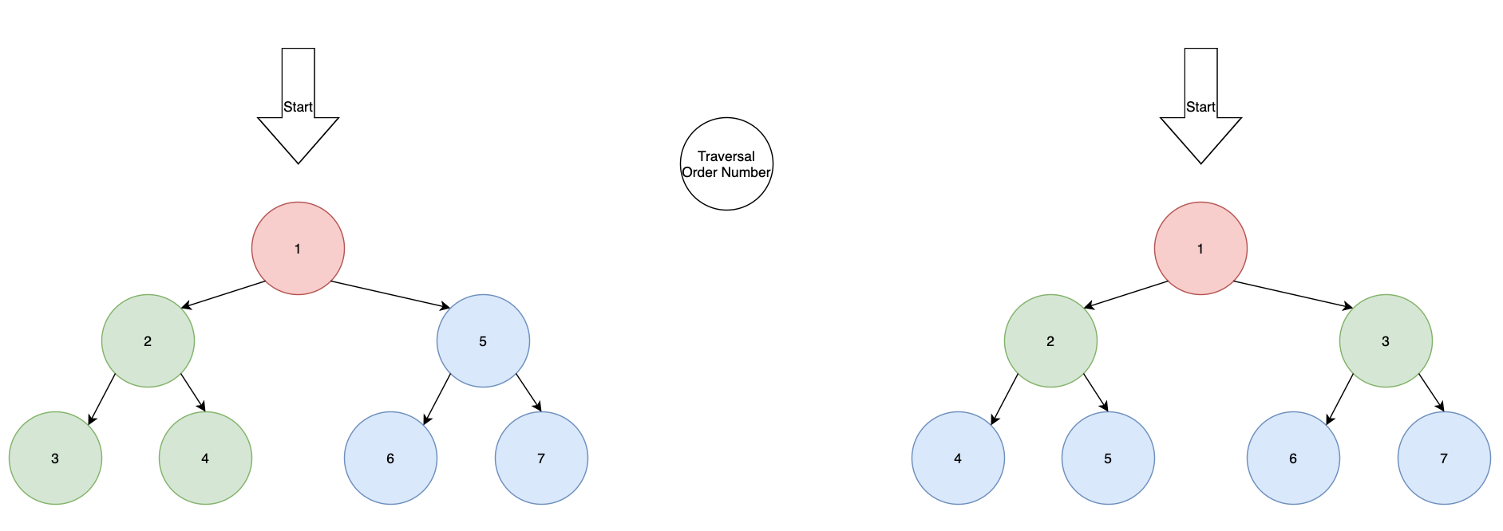
Traversing Graphs
There is not a uniform starting point that exists in every graph. Instead vertices are picked and then relations are explored to provide context or determine structure when searching a graph for specific vertices or patterns. When using graph databases most queries will utilize traversal algorithms.
Depth-First Search (DFS) - Fully explores the entire path of a vertex before backtracking to check a new path
Breadth-First Search (BFS) - Explores all incident edges of a given vertex before checking another vertex
Notes:
terminating cindition

Slide 15
Local vs. Distributed Graphs
Local
Distributed
Data Node
Data Node
Query and Data
Query Node
Data Node
Data Node
Data Node
Queries run on a single local node
Queries are distributed over a large cluster of nodes and the results returned and consolidated

Slide 16
Graph Platform Support for Algorithms
Notes:
Welcome to this Optum Tech University course on Emerging Technologies

Slide 17

TigerGraph
First Native Parallel Graph (NPG)
GSQL, custom querying language
Real time analytics on web-scale data
Built-in parallel computation
Massively Parallel Processing (MPP)
Key differentiator from other Graph Providers

Slide 18

Neo4j
Graph platform centered around native graph database
Enterprise architecture supports big data
Supports transactional applications and graph analytics
Cypher graph query language

Slide 19

AnzoGraph
Created by Cambridge Semantics
Key Features
Supports W3C standards (RDF & SPARQL) and Labelled Property Graphs (LPG)
Unique Online Analytical Processing (UOAL) database engine, well suited for large data sets
Highly parallelized and horizontally scalable

Slide 20
Graph Platform Support
As you progress through the course, you will see the logos for each graph platform
The presence of a symbol signifies that the platform supports the graph algorithm
TigerGraph
Neo4j
AnzoGraph

Slide 21
Starting TigerGraph Server and TigerGraph Studio
Everyone should have an instance of TigerGraph running on their machine, either through docker or a VM
Confirm that the ports 14240 and 9000 are exposed and have been mapped correctly, 14240 to 4142 and 9000 to 9000
Training materials are located in repo https://github.optum.com/ATC/graph-training
https://github.optum.com/ATC/graph-training/tree/master/algorithms (2.3 Branch)
https://github.optum.com/ATC/graph-training/tree/tg2.4.0/algorithms (2.4 Branch)
To load the data and predefined queries run the two following commands
“./gradlew createAndPopulateSchema”
“./gradlew installAlgorithm”

Slide 22
Categories of Algorithms
Pathfinding
Find distribution
problems, efficiencies
Centrality
Which nodes are the most connected or relevant
Community Detection
Finding things closely related to each other (friends, fraud)
Similarity
Similar paths or patterns

Slide 23
Pathfinding Algorithms
Notes:
Welcome to this Optum Tech University course on Emerging Technologies

Slide 24
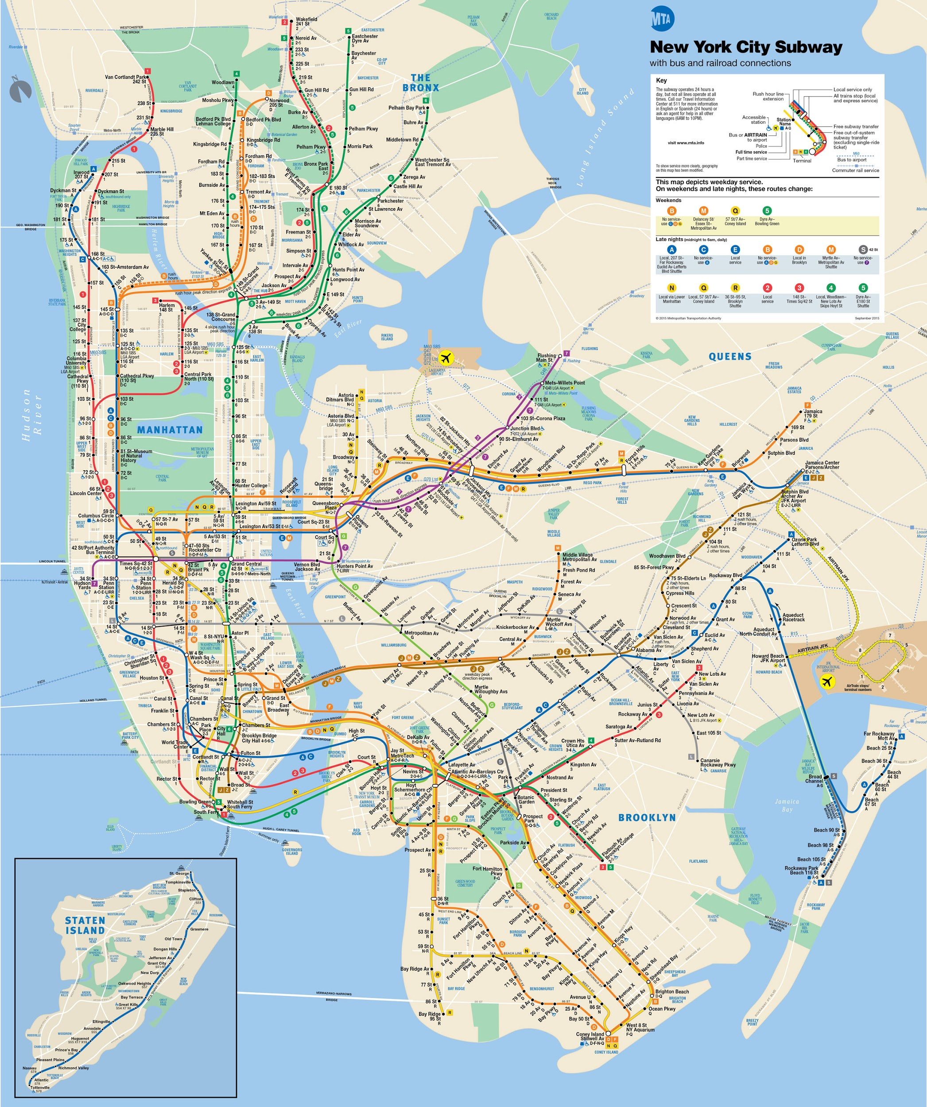
Path Finding Algorithms
Path algorithms find the shortest path or evaluate the availability and quality of paths
The path algorithms which will be covered include
Single-Source Shortest Path
All Pairs Shortest Path
Minimum Weight Spanning Tree
A*

Slide 25
Single-Source Shortest Path
The goal is to find the shortest path from one vertex to another using a greedy approach
Weighted edges - Find the path with the smallest weight
Unweighted edges - Fewest hops from one vertex to another
Dijkstra’s Algorithm: most common shortest path algorithm with many variants

Slide 26
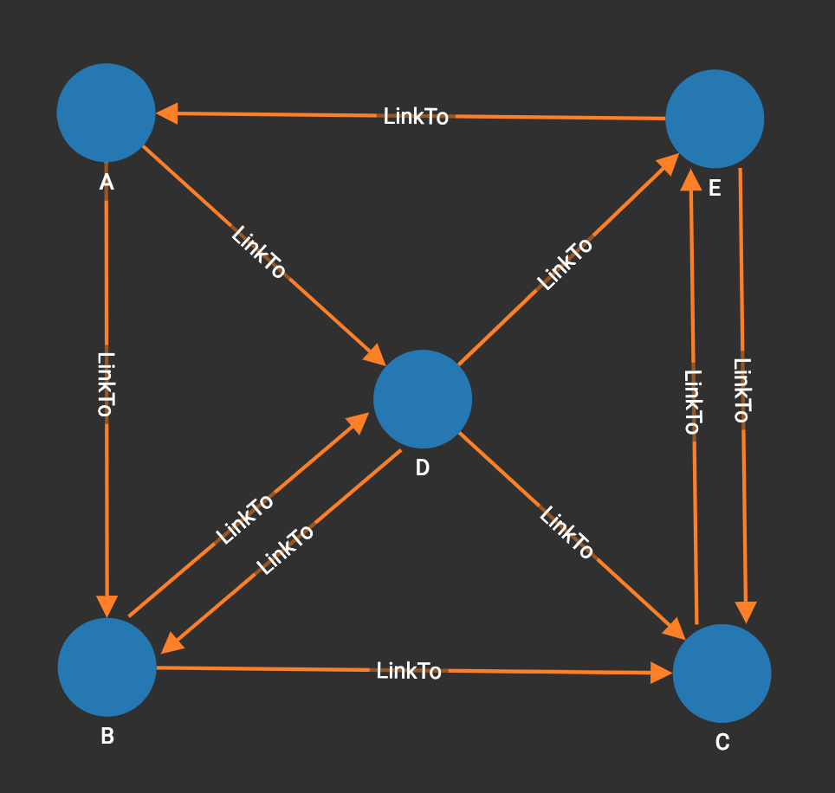
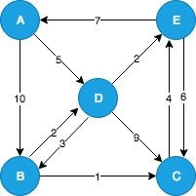
Single-Source Shortest Path
Shortest Path
A to C
Weighted Graph
A -> D -> B -> C
Unweighted graph
A -> D -> C

Slide 27
Dijkstra's Algorithm
Find the shortest path from an origin vertex
Mark all vertices unvisited
Assign a distance of infinity to all vertices except the origin, whose distance is 0. Mark the origin as the current vertex.
For the current vertex consider all unvisited neighbors and compare the current distance to the tentative distance through the current vertex. If the tentative distance is less than the current distance then update the distance for that vertex
After all neighbors have been considered mark the current vertex as visited and remove it from the unvisited set
Select the unvisited vertex with the least distance and go to step 3, unless a destination vertex has been found or all univisited vertices have distance of infinity

Slide 28
Exercise Dijkstra’s Algorithm with TigerGraph
The query “Dijkstra’sExmaple” shows an implementation of Dijkstra in TigerGraph. The input is a “Pickup” vertex type.
Recreate the following example using “Pickup” vertices and “route” edges
Let the Distance value of the route edges be the same as in the graph
What is the shortest route from A to C?
What if the graph is unweighted(All Distances are 1)?
What if a new “Pickup” vertex is added?

Slide 29
All Pairs Shortest Path
The goal is to find the shortest path between every pair of vertices in the graph
It works by running the single-source shortest path algorithm from every vertex
This is very computationally expensive for large graphs

Slide 30
All Pairs Shortest Path
Start any random vertex V
Find the shortest path from V to every other vertice
Repeat until path from every vertice to each other have been found
When a vertex is reached and the weight on two edges is the same, either may be chosen
Paths from A | B | C | D | E
Path | A->D->B | A->D->B->C | A->D | A->D->E
Weight | 8 | 9 | 5 | 7

Slide 31
Minimum Weight Spanning Tree
A Minimum Weight Spanning Tree (MWST) is the set of edges that connects all vertices in the graph with the minimum sum of edge weight
This is only useful for weighted and connected graphs
Prims Algorithm: greedy MWST algorithm that can tolerate negative edge weights and is efficient for dense graphs
Kruskal’s Algorithm: greedy MWST algorithm that is efficient for sparse graphs

Slide 32
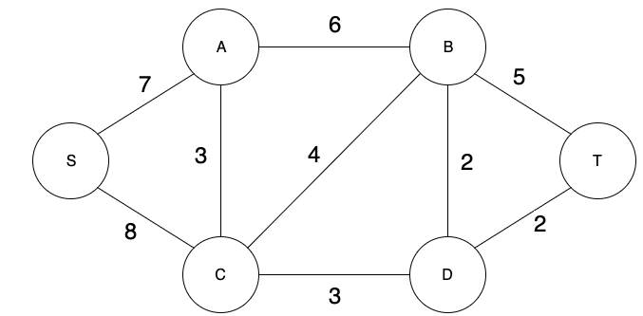
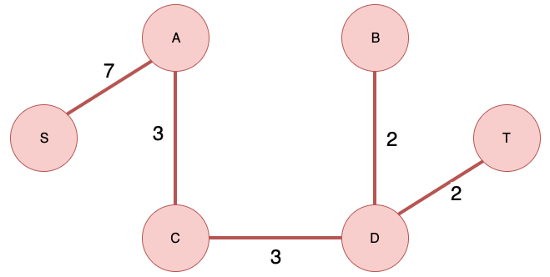
Minimum Weight Spanning Tree
Define an empty set called visited and a set called unvisited containing all vertices. Chose an arbitrary vertex to add to the visited set, in this case S.
Choose a minimum weighted edge that connects a vertex from the visited set to the unvisited set. Move the connected vertex from the unvisited set to the visited set.
Repeat step 2 until all vertices are contained in the visited set
When a vertex is reached and the weight on two edges is the same, either may be chosen

Slide 33
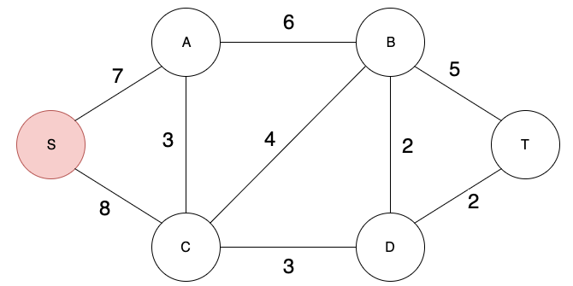
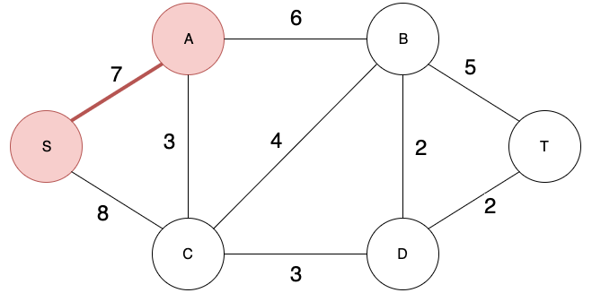
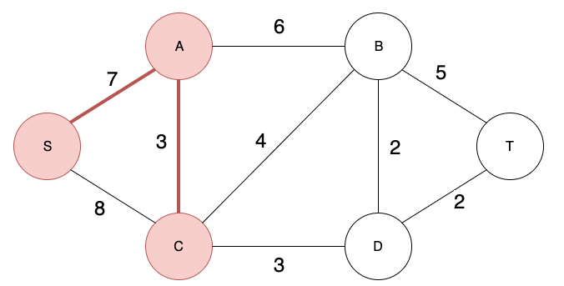
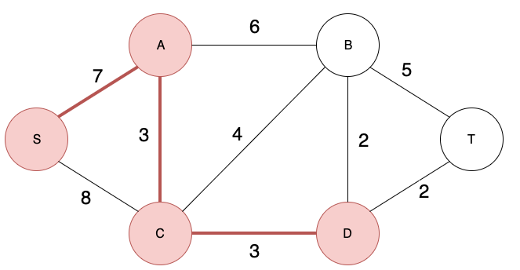
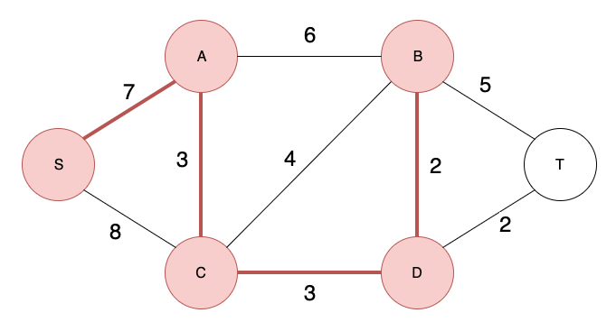
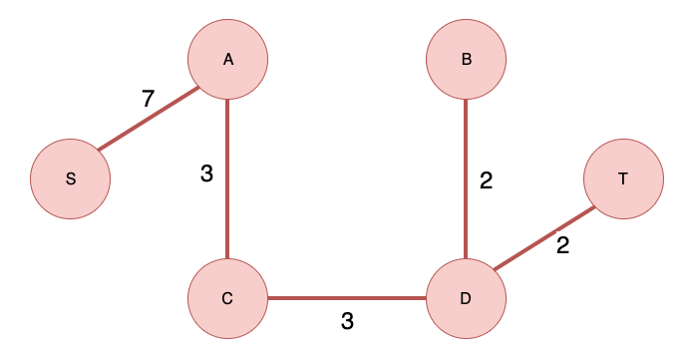
Minimum Weight Spanning Tree Example

Slide 34
A* (A star)
The A* algorithm improves on Dijkstra’s Algorithm using heuristics to achieve better performance
It’s an informed search algorithm that balances the exact cost from the start to any vertex and the estimated cost from any vertex to the goal
Heuristic algorithm: a component that is designed to solve a problem more quickly and efficiently than traditional algorithms. The trade off is usually accuracy and precision

Slide 35
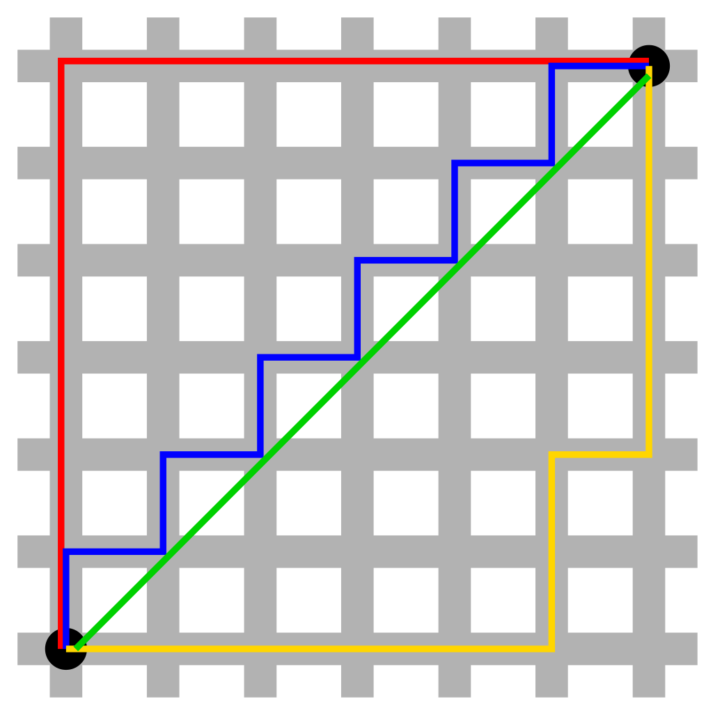
A* (A star)
A* expands paths by using the function:
f(v) = g(v) + h(v)
Where g(v) is the cost so far to reach the vertex v and h(v) is the heuristic that estimates the cost from v to the goal
Manhattan Distance Heuristic: the sum of horizontal and vertical distances between two points
h(x, y) = |x1 – x2| + |y1 – y2|
Red, blue, and yellow are equivalent Manhattan Distances. Green is shortest distance ignoring boundaries

Slide 36
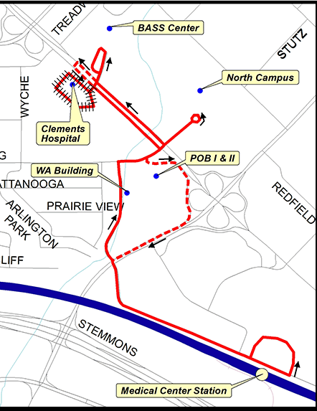
Shortest Path Use Case
Routing logistics is one place where shortest path is especially suited
The shortest path algorithms can provide optimal routing for a shuttle service that provides pickup and dropoff for patient

Slide 37
Centrality Algorithms
Notes:
Welcome to this Optum Tech University course on Emerging Technologies

Slide 38
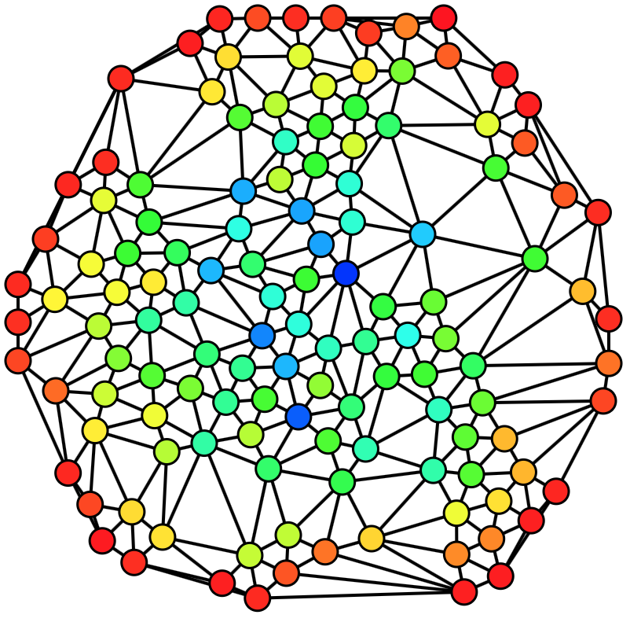
Centrality Algorithms
Centrality algorithms determine the importance of each vertex, such closeness or degree, within a graph
The centrality algorithms which will be covered include
PageRank
Closeness Centrality
Degree Centrality

Slide 39
PageRank
PageRank recursively measures the transitive influence of vertices on each other
It helps determine the relevance and importance of each vertice using the number of connections and the quality of connections a vertex has
Created by Larry Page (co-founder of Google) while attending Stanford University. PageRank became the basis for the original Google search engine
May only be used for graphs with directed edges

Slide 40
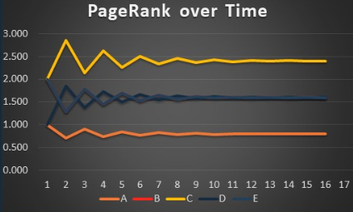
PageRank
PageRank Formula: PR(A) = (1-d) + d (PR(T1)/C(T1) + … + PR(Tn)/C(Tn))
PR(A) = the PageRank score of page A
PR(Tn) = the current PageRank score for page n
C(Tn) = number of outgoing links
d = dampening factor (usually set at 0.85) to stop pages from being too influential
(1-d) = adds what is lost by d to achieve an average/normalised sum of 1
This is performed iteratively until the scores don’t change more than a decimal place between iterations, meaning they are approaching their final estimated value

Slide 41
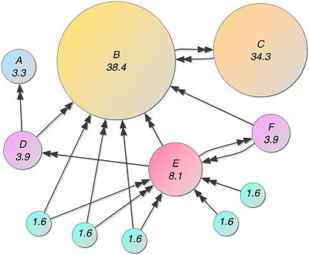
PageRank Use Case
For example if the vertex B represents a respected knee surgeon, where the links are the referrals from patients and doctors
incoming connections = score
Vertex C, a respected physical therapist, is referred by the influential surgeon B making it important by relation
score of incoming connections = score
Surgeon E is from a small community and has many referrals, but are primarily from patients within the community and do have as much influence

Slide 42
Closeness Centrality
Measures how centrally located a vertex is in a graph, to detect which vertices are able to efficiently spread information
Centrally Located - Implies there are many edges and short paths to all other vertices
The facility that is the most central will be the most frequently visited and is likely to have better resources
Only useful for connected graphs

Slide 43
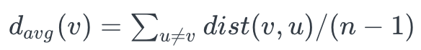
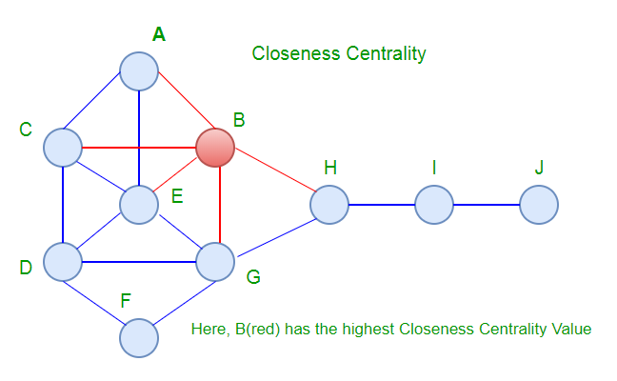
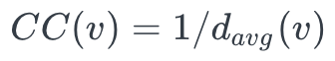
Closeness Centrality Algorithm
Computes average distance from the vertex to every other vertex
Inverts the average distance so that higher score reflects shorter distances
Repeated for every vertex in the graph
Precise numerical value is given for the measurement

Slide 44
Exercise Closeness Centrality with TigerGraph
The “ClosenessCentralityExample” query calculates which organization is most centrally located when compared to all organizations in the data set provided
What is the most centrally located organization according to the query? The farthest out?
How do the results change when a different distance formula is used like Euclidean or Manhattan?
What if an average of the distance metrics are used?

Slide 45
Degree Centrality
Measures the degree of a vertex, or the number of outcoming and incoming relationships
Degree: number of edges connected to a vertex
Uses
Finds the most well connected vertices in the graph
Calculate minimum degree, maximum degree, mean degree, and standard deviation across entire graph

Slide 46
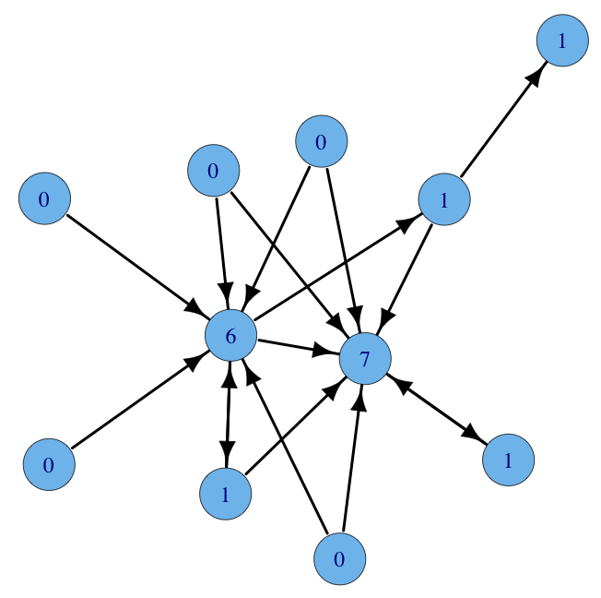
Degree Centrality
Directed Graph
In-degree - Measure incoming connections
Out-degree - Measure outgoing connections
Undirected Graph
Measure any connection
In this example, the vertices with a 6 and a 7 have high in-degree centrality
In-degree centrality

Slide 47
Exercise Degree Centrality with TigerGraph
Navigate to the “DegreeCentralityExample” query in TigerGraph studio
The function outdegree() will return the number of outbound edges for a given type
If no parameter is provided then a count of all outdegree edges is returned
The pre-installed version of the query will return all visits of a provider
Looking at the schema what other edge types may provide some insight for a provider?

Slide 48
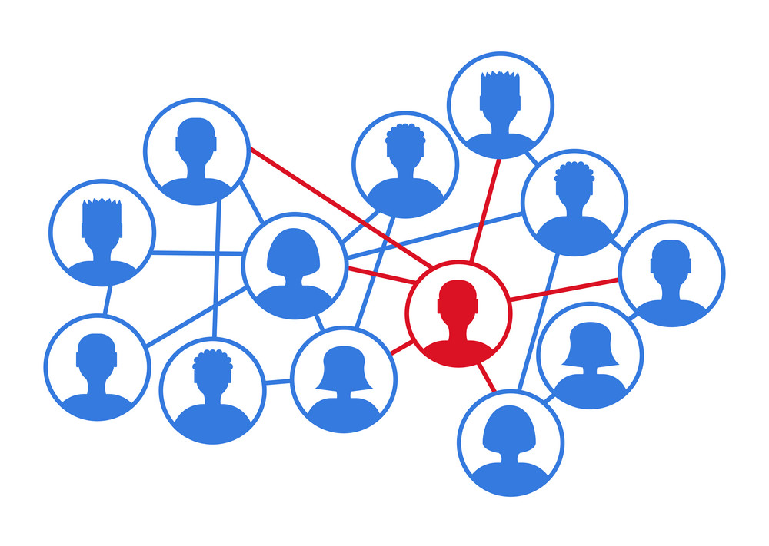
Centrality Use Case
Centrality has uses in the healthcare field by giving the ability to see which surgeons are performing the most procedures or reviewing the number of claims process
It can also be used to help identify negative impacts, such as bad reactions to medications against the general patient population

Slide 49
Community and Similarity Algorithms
Notes:
Welcome to this Optum Tech University course on Emerging Technologies

Slide 50
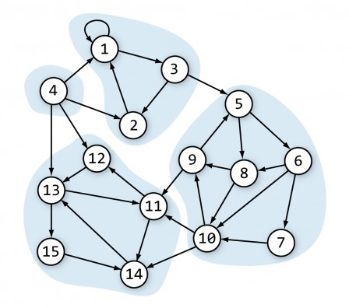
Community Algorithms
Community algorithms evaluate how a group is clustered or partitioned, as well as its tendency to strengthen or break apart
The community algorithms which will be covered include
Label Propagation
Louvain Modularity
Triangle Counting
Connected Components

Slide 51
Label Propagation
Detects communities in a graph by propagating labels throughout the graph and forming groups based on the labels
Label: a classification given in the form of an attribute
If most of vertex v’s neighbors have label X, than vertex v is probably also X
This algorithm is very fast and can be assisted by hand labeling some vertices before execution

Slide 52
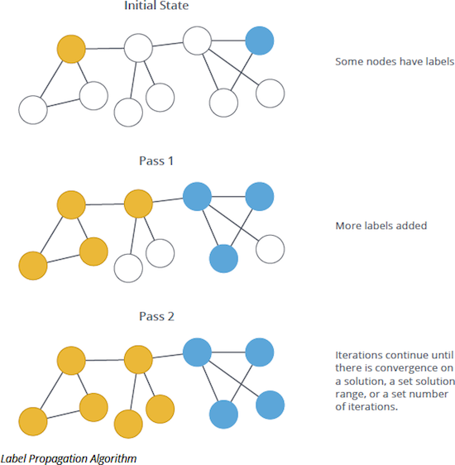
Label Propagation
Heuristic method to determine communities
Give each vertex unique label
Iteratively update labels based on neighbor influence (if most neighbors have label X you should also be label X). Note, the order for this is random
Due to the randomness of updating, the results may not be exactly the same across multiple runs

Slide 53
Louvain Modularity
Detects communities by relying on heuristics for maximizing modularity
Modularity: measures the strength of division of a graph/network into clusters/modules
Gets the name ‘Louvain’ from a team a researchers at the University of Louvain that created this particular heuristic

Slide 54
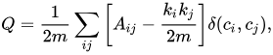
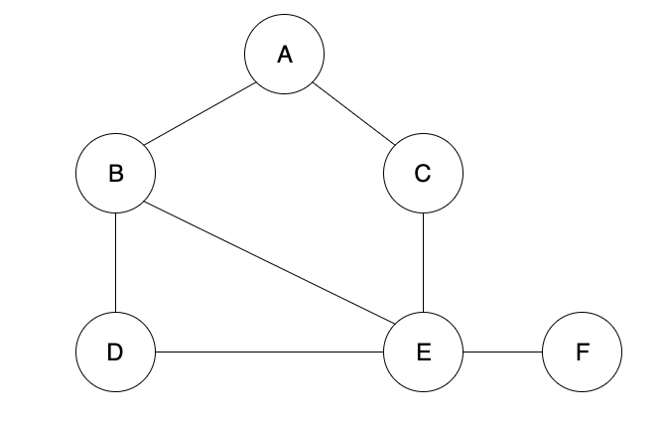
Scoring Modularity of a Graph
The modularity of a graph is defined as
m - The sum of all edge weights in the graph
A_{ij} - The sum of edge weights between vertices i and j
k_{i}, k_{j} - The sum of edges attached to vertices i and j
c_{i}, c_{j} - The communities of vertices i and j
- Simple delta, 1 if same community, 0 if not same community

Slide 55
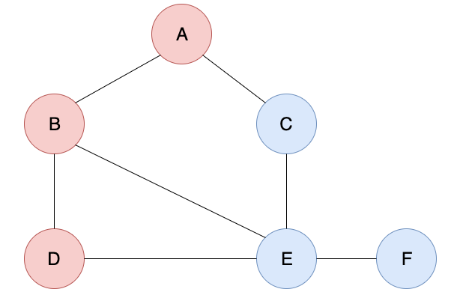
Example Scoring Modularity
= 1 / ( 2 * 7 ) [
(0 - (2 * 2)/ (2 * 7) ) * 1
+(1 - (2 * 3)/ (2 * 7) ) * 1
+(1 - (2 * 2)/ (2 * 7) ) * 0
+( 0 - (2*2)/ (2 * 7) ) * 1
+( 0 - (2*4)/ (2 * 7) ) * 0
+( 0 - (2*2)/ (2 * 7) ) * 0
…
+(0 - (1*1)/ (2 * 7) * 1]
= 1/14[0 + 7/14 + 0 + 10/14 + 8/14 + 7/14 ]
= 1/14 [32/14] = 32/196 = 0.163
 | A | B | C | D | E | F
A | 0 | 1 | 1 | 0 | 0 | 0
B | 1 | 0 | 0 | 1 | 1 | 0
C | 1 | 0 | 0 | 0 | 1 | 0
D | 0 | 1 | 0 | 0 | 1 | 0
E | 0 | 1 | 1 | 1 | 0 | 1
F | 0 | 0 | 0 | 0 | 1 | 0

Slide 56
Louvain Modularity Algorithm
First start by assigning every vertex to its own community. Then for each vertex in a community calculate the change in modularity, which is given by the formula
Sum of all weights of edges from other communities to the target community
Sum of weights from vertices in the new community to the vertex k
Sum of all weights of edges inside the target community
Weighted Degree of vertex to move
Sum of all weights in the entire graph
The highest non-negative value community is always chosen as the new community for the vertex tested

Slide 57
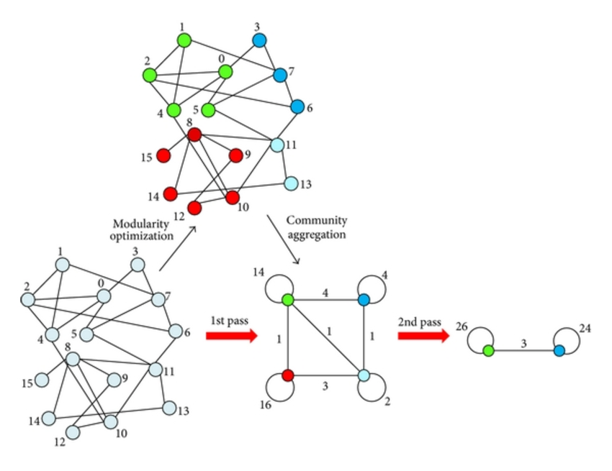
Louvain Modularity Algorithm
The scoring process is done for every vertex in the graph, when there is a pass, such that no vertex has changed communities then the algorithm is finished
At this point each community is collapsed down into their own vertex
All internal edges from the old community are represented as loops
The algorithm can now be rerun on the new network

Slide 58
Triangle Counting
Determines the number of triangles passing through each node in a graph to measure community and connectedness
Triangle: set of three vertices, where each vertex has an edge connecting it to the other two vertices
Also known as Clustering Coefficient Algorithm
Useful for determining stability of graph or for measuring the cohesiveness of communities

Slide 59
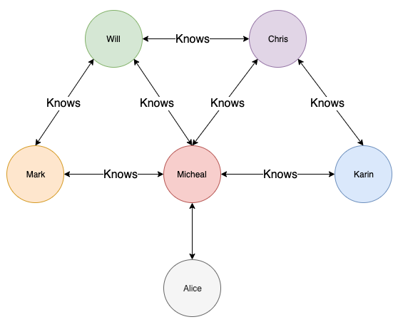
Triangle Counting
Can be used to identify transitive relationships:
If A -> B and B -> C, then it is likely that A -> C
More commonly used in undirected graph to determine the clustering coefficient
The degree to which nodes tend to connected and cluster together

Slide 60
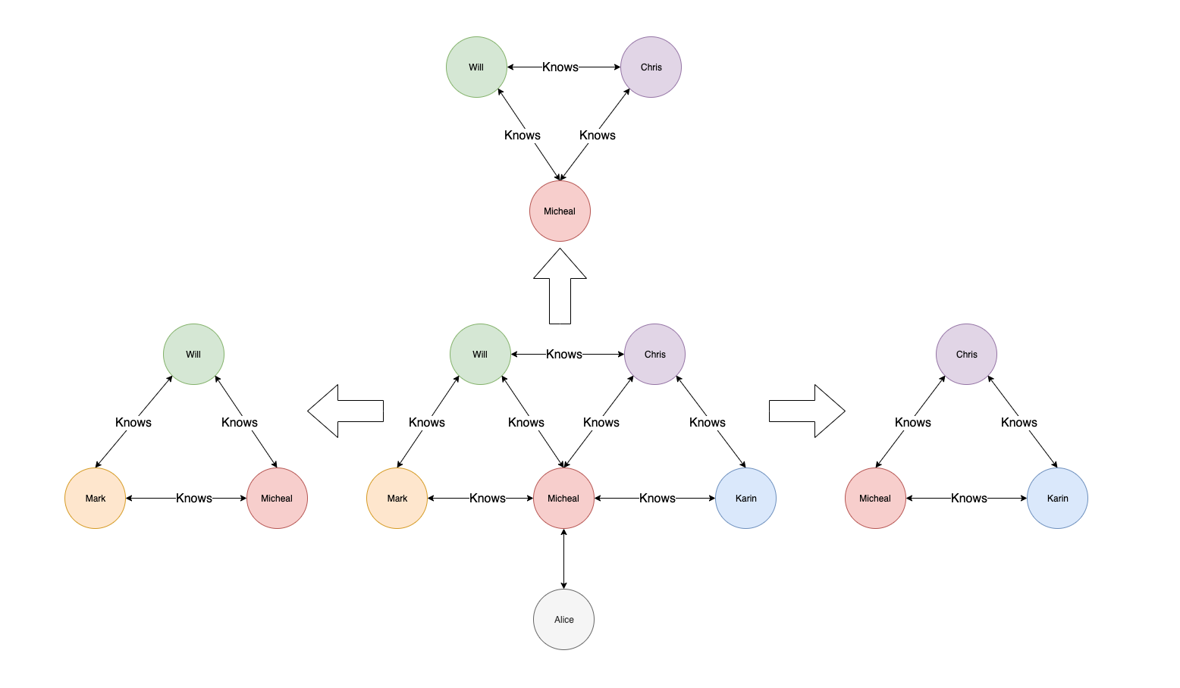
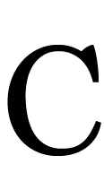
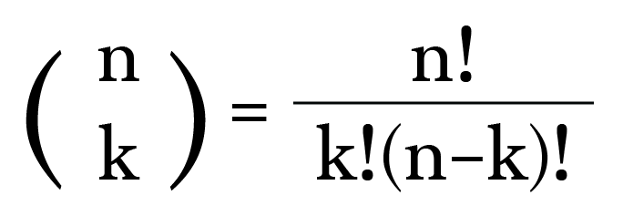
Triangle Counting Algorithm
To calculate the clustering coefficient look at the fully realized number of connections against the number of actual connections
That is for a given vertex v, the number of triangles v is involved divided by C( k, 2 ), where is k is the number of neighboring vertices

Slide 61
Triangle Counting Algorithm
To calculate the clustering coefficient look at the fully realized number of connections against the number of actual connections
That is for a given vertex v, the number of triangles v is involved divided by C( k, 2 ), where is k is the number of vertices
Vertex | Triangles | C(k,2) | Clustering Coefficient
Micheal | 3 | C(5,2) = 10 | 3 / 10 = .3
Chris | 2 | C(3,2) = 3 | 2 / 3 = .666
Karin | 1 | C(2,2) = 1 | 1 / 1 = 1
Will | 2 | C(3,2) = 3 | 2 / 3 = .666
Mark | 1 | C(2,2) = 1 | 1 / 1 = 1
Alice | 0 | C(1,2) = 0 | 0

Slide 62
Connected Components
Connected Components are a set of vertices and their edges which are interconnected
Only applies to undirected graphs
Support for directed is not provided by any of the 3 platforms, but if available the Strongly Connected Components algorithm and the Weakly Connected Components algorithm are used for directed graphs

Slide 63
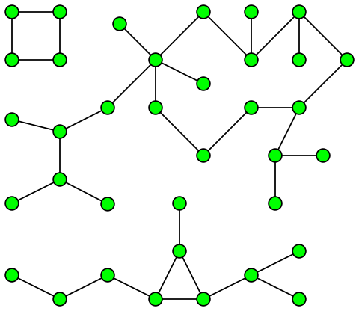
Connected Components
Component: sometimes called connected component, is a subgraph such that there exists a path between any two vertices within the subgraph and there does not exist a path between a vertex in the subgraph and a vertex in the super graph.
Each cluster of vertices is a single component, so there are 3 connected components

Slide 64
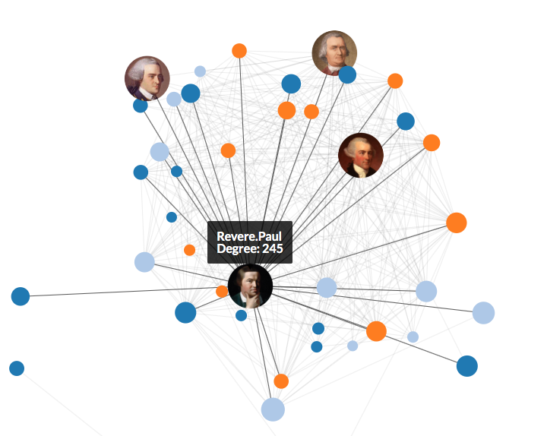
Similarity Algorithms
Similarity algorithms compare vertices and/or the relationship of two vertices to measure their similarity
The similarity algorithms which will be covered include
Cosine Similarity
Jaccard Similarity
Pearson Similarity
Overlap Similarity

Slide 65
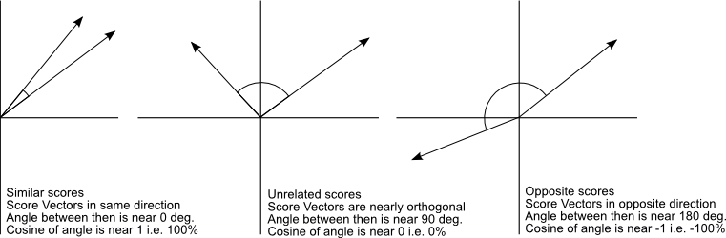
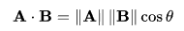
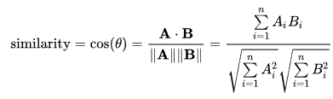
Cosine Similarity
Cosine Similarity is the cosine of the angle between two vectors. A vector is created from the properties of a vertex
This is commonly used for making recommendations
The score is on a scale of -1 to 1

Slide 66
Cosine Similarity
Cosine similarity is most commonly used in high dimensional positive spaces, for example text mining
Each term that appears is assigned to a dimension where the value is determined by frequency of appearance within a text document
A similar approach can also be used to assign a given property or relationship to dimension, can be weighted or simple binary value if present or not present
One advantage is that cosine similarity is not very complex to implement.
Works well for sparse vectors as only the non-zero dimensions need to be considered

Slide 67
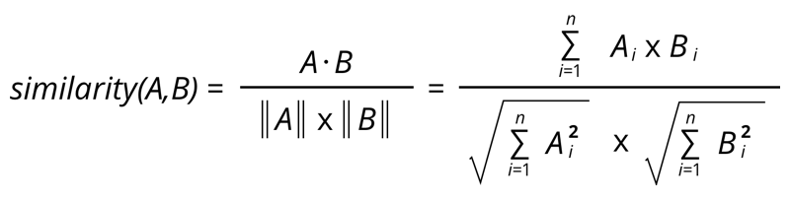
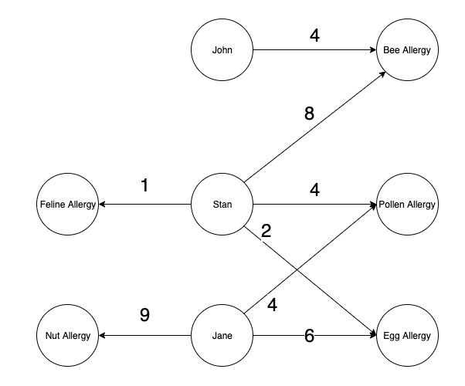
Cosine Similarity
The formula for calculating the similarity of two vectors:
A * B = the dot product of vector A and B
‖A‖ = the magnitude of vector A
In this graph, the severity of an allergy is used to provide values for the attributes

Slide 68
Cosine Similarity Example
How similar are Jane and Stan when it comes to shared allergy severity?
Let A = Stan = { Pollen Allergy: 4, Egg Allergy: 2}
Let B = Jane = {Pollen Allergy: 4, Egg Allergy: 6}
||A|| = sqrt( 4² + 2²) ~ 4.4721
||B|| = sqrt( 4² + 6²) ~ 7.2111
A· B = 4*4 + 2 * 6 = 28
Similarity(A,B) = cos(θ) = A· B / (||A||||B||) =
28 / (4.4721 * 7.2111) = 0.86825

Slide 69
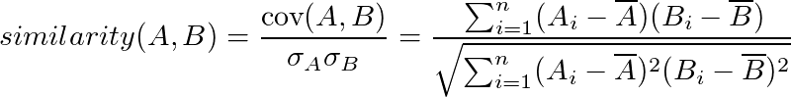
Pearson Similarity
Measures the similarity using the linear correlation of two vectors by calculating the covariance divided by the product of their standard deviations
The scores range from -1 to 1 where 1 is identical and -1 is completely opposite
cov(A, B) - Covariance
σ - Standard Deviation

Slide 70
Pearson Similarity
Pearson Similarity is essentially the cosine similarity between two centered vectors, because it is invariant to shifts
This can be especially useful for finding correlations among numerical values. For example, two attributes ‘age’ and ‘salary’ would likely have a strong positive correlation as they both grow together
Age
Salary

Slide 71
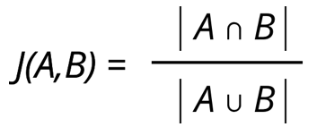
Jaccard Similarity
Measures the similarity or relative overlap between two sets of data by dividing the size of the intersection by the size of the union
The range of scores is from 0 - 1 where 1 is identical
Sets of data can be created through a graph using attributes from vertices and edges
This can be run with a single source or on all pairs. Running it on all pairs would be inefficient for a large, dense graph

Slide 72
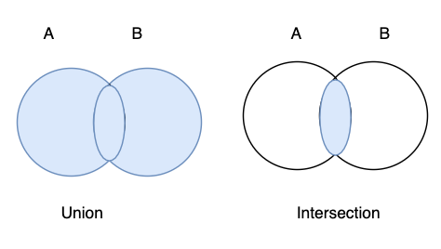
Jaccard Similarity Use Case
For example both John Doe and Jane Doe have been diagnosed with the same disease, comparing their age, race, ethnicity and gender, how similar are these individuals?
Let John Doe be set A = { 35, “White”, “Italian”, M}
Let Jane Doe be set B = { 35, “White”, “French”, F }
A ∩ B = { 35, “White” }
A ∪ B = { 35, “White”, “Italian”, “French”, M, F }
|A ∩ B| = 2
|A ∪ B| = 6
Similarity(A, B) = 2 / 6 = .333
The magnitude of the union of sets A & B divided by the magnitude of the intersection of sets A & B.

Slide 73
Jaccard Similarity Use Case
Comparing two patients against each other also may not be as valuable as comparing a single patient against a general population
Let John Doe be set A = { 35, “White”, “Italian”, M}
Let Jane Doe be set B = { 35, “White”, “French”, F }
A ∩ B = { 35, “White” }
A ∪ B = { 35, “White”, “Italian”, “French”, M, F }
|A ∩ B| = 2
|A ∪ B| = 6
Jaccard Similarity(A, B) = 2 / 6 = .333

Slide 74
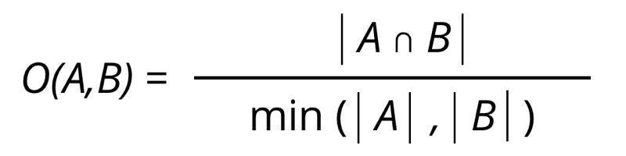
Overlap Similarity
Measures the similarity or relative overlap between two sets of data by dividing the size of the intersection by the size of the smaller of two sets
Useful for finding subsets in a graph
This is very similar to Jaccard Similarity, with the denominator being the only difference, values still range 0 - 1
Also known as the Overlap coefficient or Szymkiewicz–Simpson coefficient

Slide 75
Overlap Similarity Use Case
Most importantly by building a taxonomy of symptoms for given patients can help more efficiently diagnose underlying illnesses and care plan
Compare the symptoms of John Doe and Jane Doe to see potential overlap
John Doe is set A = {“Headache”, “Nausea”, “Soreness”, “Fever”, “Fatigue”}
Let Jane Doe be set B = {“Fever”, “Headache”, “Fatigue”, “Vomiting”}
A ∩ B = { “Fever”, “Headache”, “Fatigue” }
|A| = 5
|B| = 4
|A ∩ B| = 3
min( |A|, |B|) = 4
Overlap Similarity(A, B) = ¾ = .75
The magnitude of the intersection of sets A & B divided by the magnitude of the smallest set of A or B

Slide 76
Similarity and Component Use Case
One of the greatest issues in healthcare is the duplication or miscatagorization of patient data
Even the first name of a patient can be problematic
A patient with a legal name of “Daniel”, may simply put “Dan” or “Danny” as an alias
How do we confirm that “Daniel” is in fact the “Dan” that has been recorded and not another individual?
Using connectedness and similarity algorithms can we establish with a reasonable level of confidence that pieces of information resolve to the same underlying entity?

Slide 77
Entity Resolution
Entity resolution, or record linkage, refers to the task of finding records that refer to the same entity across multiple data sources that do not share a common universal identifier
A combination of community and similarity algorithms are actually well suited for helping to determine if data from multiple sources resolves to the same entity because of the importance that graph databases place on relationships

Slide 78
Final Remarks

Slide 79
Closing Remarks
There exist a plethora of graph algorithms, each serve a different purpose and strive for a given result
Some are more theoretical and some are more practical for real world applications
There are advantages and disadvantages to each that must be weighed with the problem that is trying to be solved

Slide 80
Thank you! Any questions?

